Slide 1
Generative Vision Models
Lecture 1
Part 3
Generative AI for Computer Vision

Slide 2
Content
Generative Modelling for Computer Vision
Generative Vision Models
Applications in Computer Vision

Slide 3
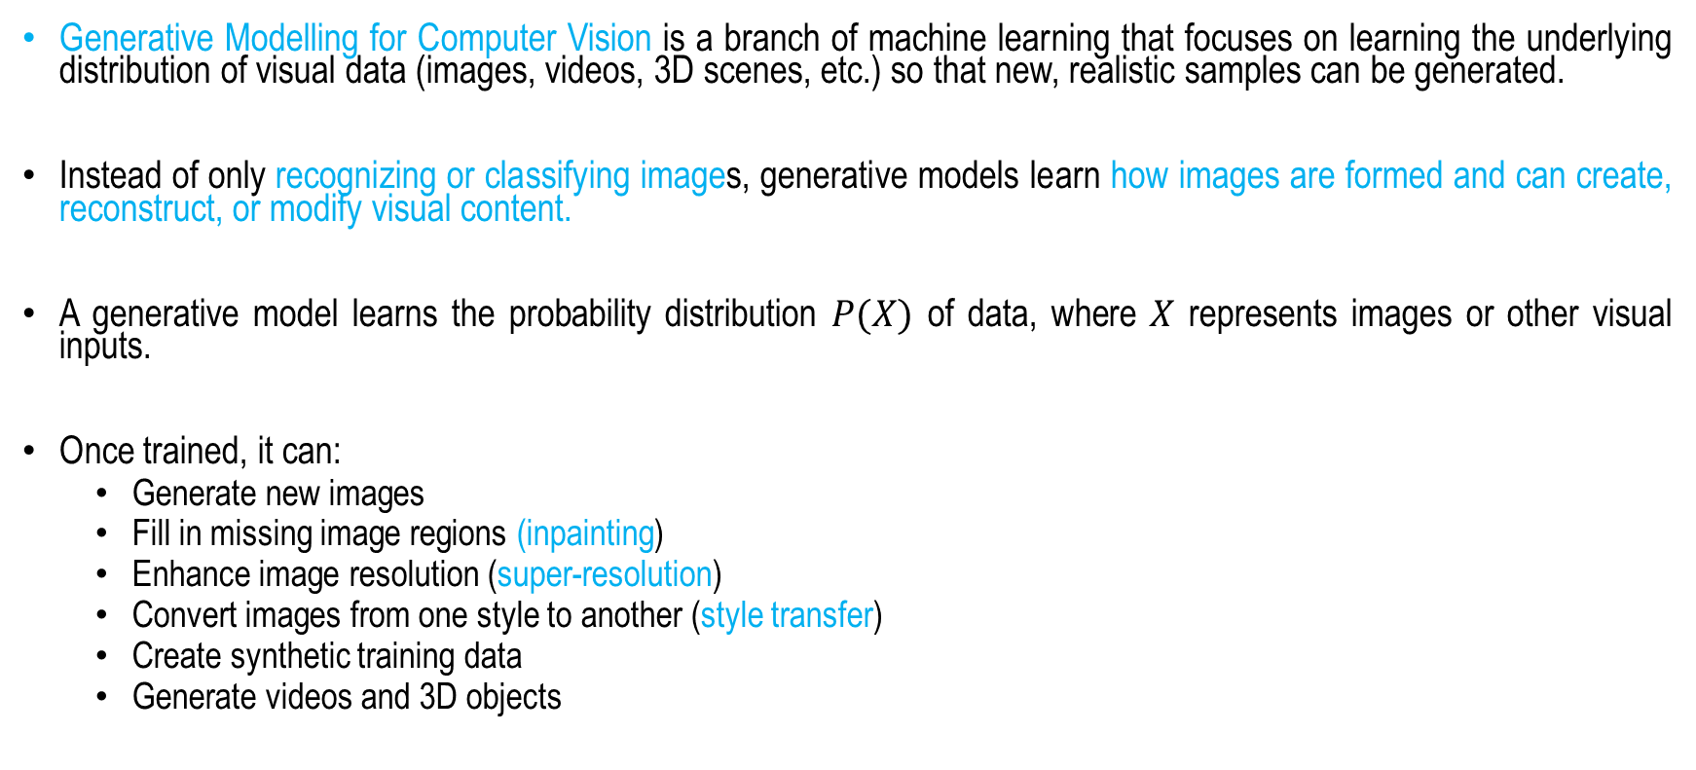
Generative Modelling for Computer Vision
Generative Modelling for Computer Vision is a branch of machine learning that focuses on learning the underlying distribution of visual data (images, videos, 3D scenes, etc.) so that new, realistic samples can be generated.
Instead of only recognizing or classifying images, generative models learn how images are formed and can create, reconstruct, or modify visual content.
A generative model learns the probability distribution $P(X)$ of data, where $X$ represents images or other visual inputs.
Once trained, it can:
  Generate new images
  Fill in missing image regions (inpainting)
  Enhance image resolution (super-resolution)
  Convert images from one style to another (style transfer)
  Create synthetic training data
  Generate videos and 3D objects

Slide 4
Generative Vision Models
Variational Autoencoders (VAEs)
Generative Adversarial Networks (GANs)
Autoregressive Models
Diffusion Models
Normalizing Flows

Slide 5
Variational Autoencoder (VAE)
A Variational Autoencoder (VAE) is a type of generative neural network that learns a compressed, continuous representation of data and can generate new samples similar to the training data.
Unlike a standard autoencoder, which maps an input to a single point in latent space, a VAE maps an input to a probability distribution (typically a Gaussian).
VAEs use encoder-decoder architecture with variational inference to model data distributions, allowing for tasks like image synthesis, denoising, and anomaly detection.

Slide 6
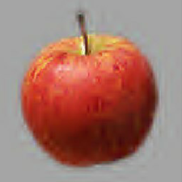
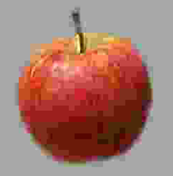
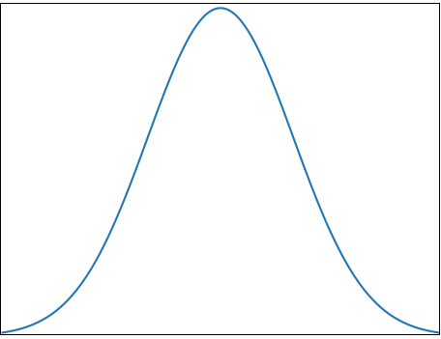

Normal Auto-Encoder vs Variational Auto-encoder
L (Latent space)
L (Latent space)
L (Latent space)
0.9
0.3
0.1
0.2
Encoder
0.7
Encoder
Decoder
Encoder
Decoder
0.5
Values
Generator
Distributions
Generator
Auto-Encoder
Variational Auto-Encoder
Image Source: Bultheel, Adhemar & Jansen, Maarten & Maes, Jan & Aerschot, Ward & Vanraes, Evelyne. (2006). Subdivide and conquer resolution. 12-14.

Slide 7
Vision Tasks using VAE
Generate new images, video frames etc.
Learn meaningful latent representations.
Perform interpolation between image samples.
Image compression and anomaly detection.

Slide 8
Generative Adversarial Networks (GANs)
A Generative Adversarial Network (GAN) is a generative deep learning model that learns to create realistic synthetic data—such as images, audio, or text—by training two neural networks in competition with each other.
GAN consists of two deep neural networks which compete with each other.
A GAN consists of:
  Generator (G): Creates fake data from random noise. Tries to produce outputs that look real.
  Discriminator (D): Receives both real and generated data. Tries to distinguish between them.

Slide 9
Generator
The Generator can be thought of as a skilled forger whose objective is to create synthetic data that is indistinguishable from real data.
It begins with a random input vector, denoted as Z, which is typically sampled from a simple probability distribution such as a Gaussian or Uniform distribution.
This vector serves as a latent representation, encoding abstract features that guide the generation process. The Generator then transforms this noise vector into a synthetic sample, G(Z), such as an image.
An intuitive analogy is that of an artist starting with random scribbles and gradually refining them into a convincing masterpiece.
Through training, the Generator learns to map points in the latent space to realistic data samples, with the ultimate goal of producing outputs that are realistic enough to fool the Discriminator into classifying them as genuine.

Slide 10
Discriminator
The Discriminator (D) can be viewed as a skilled detective whose role is to distinguish between authentic data and synthetic data produced by the Generator.
It receives a data sample as input—either a real example from the training dataset or a fake sample generated by the Generator—and outputs a probability score, D(X), representing the likelihood that the sample is genuine.
A value close to 1 indicates that the Discriminator believes the sample is real, while a value close to 0 suggests that it is likely fake.
An intuitive analogy is that of an art expert examining a painting and determining whether it is an original masterpiece or a carefully crafted forgery.
Throughout the training process, the Discriminator continuously improves its ability to detect subtle differences between real and generated data, providing feedback that helps the Generator produce increasingly realistic samples.

Slide 11
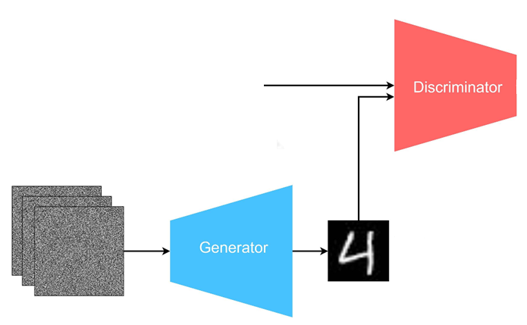

Generative Adversarial Networks (GANs)
Real Data
Adversarial
Loss
Fake Data
Latent Variables
Gaussian Noise
Generated Fake Data

Slide 12
Why GAN is good for image generation?
GANs are particularly effective for image generation because of the way they are trained. Instead of trying to reconstruct every pixel exactly, they learn to produce images that look realistic to a discriminator network.
Adversarial Training Encourages Realism
  The generator's goal is to fool the discriminator into believing generated images are real.
  The discriminator learns features that distinguish real images from fake ones.
  The generator learns to match those features. This pushes the generator to create realistic textures, edges, lighting, and fine details.
Produces Sharp Images
  Many traditional generative models (including early VAEs) optimize pixel-by-pixel reconstruction losses.
  For a reconstruction loss such as MSE the model often averages multiple plausible outputs, leading to blurry images.
  GANs avoid directly minimizing pixel errors and instead optimize perceptual realism, which typically results in sharper images.

Slide 13
Why GAN is good for image generation?
Learns Complex Data Distributions
  Images have highly complex distributions such as Objects, Shapes, Colors, Textures, Spatial relationships, etc.
  GANs can learn these patterns without explicitly modeling probabilities, allowing them to generate realistic samples from high-dimensional image spaces.
Generates High-Frequency Details:
  GANs excel at generating Hair strands, Skin textures, Fur, Grass, Fine edges, etc.
  These details are often difficult for reconstruction-based models to reproduce accurately.
Continuous Latent Space:
  GAN maps a latent vector z to an image. Nearby latent vectors tend to generate similar images, enabling, Image interpolation, Attribute manipulation, Style transfer.
  For example, smoothly moving through latent space can gradually change: Facial expression, Age, Hair, color, Pose, etc.

Slide 14
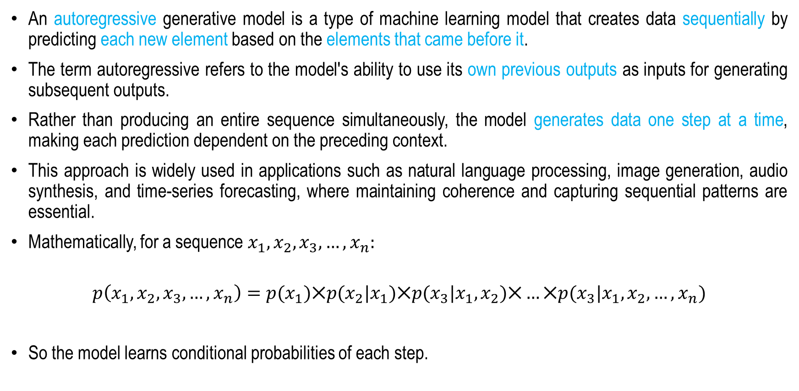
Autoregressive Generative Model
An autoregressive generative model is a type of machine learning model that creates data sequentially by predicting each new element based on the elements that came before it.
The term autoregressive refers to the model's ability to use its own previous outputs as inputs for generating subsequent outputs.
Rather than producing an entire sequence simultaneously, the model generates data one step at a time, making each prediction dependent on the preceding context.
This approach is widely used in applications such as natural language processing, image generation, audio synthesis, and time-series forecasting, where maintaining coherence and capturing sequential patterns are essential.
Mathematically, for a sequence $x_{1}, x_{2}, x_{3}, …, x_{n}:$
$$p\left(x_{1}, x_{2}, x_{3}, …, x_{n}\right)=p(x_{1})⨉p(x_{2}|x_{1})⨉p(x_{3}|x_{1},x_{2})⨉…⨉p(x_{3}|x_{1},x_{2},…,x_{n})$$
So the model learns conditional probabilities of each step.

Slide 15
Autoregressive Models
PixelRNN – One of the earliest autoregressive image generation models, PixelRNN generates images pixel by pixel using recurrent neural networks (RNNs).
It captures complex spatial dependencies but is computationally expensive due to its sequential nature.
PixelCNN – PixelCNN replaces recurrent networks with masked convolutional layers, enabling faster training while still generating images one pixel at a time.
Variants such as PixelCNN++ further improve image quality and training stability.
Vision Transformer – This model applies the Transformer architecture to image generation by treating images as sequences of pixels or image patches.
Self-attention mechanisms allow it to model long-range dependencies more effectively than CNN-based approaches.

Slide 16
Recent Autoregressive Models
VQ-VAE + Transformer – Vector Quantized Variational Autoencoders (VQ-VAE) compress images into discrete latent codes.
An autoregressive Transformer then models and generates these codes, producing high-quality images with reduced computational cost.
DALL·E (Original Version) – DALL·E uses a Transformer-based autoregressive architecture to generate images from text descriptions.
It models images as sequences of discrete visual tokens and predicts them sequentially based on the input text and previously generated tokens.
Parti – Parti is a large-scale autoregressive Transformer developed for text-to-image synthesis.
It generates image tokens sequentially and demonstrates strong capabilities in producing detailed and coherent images from complex text prompts.

Slide 17
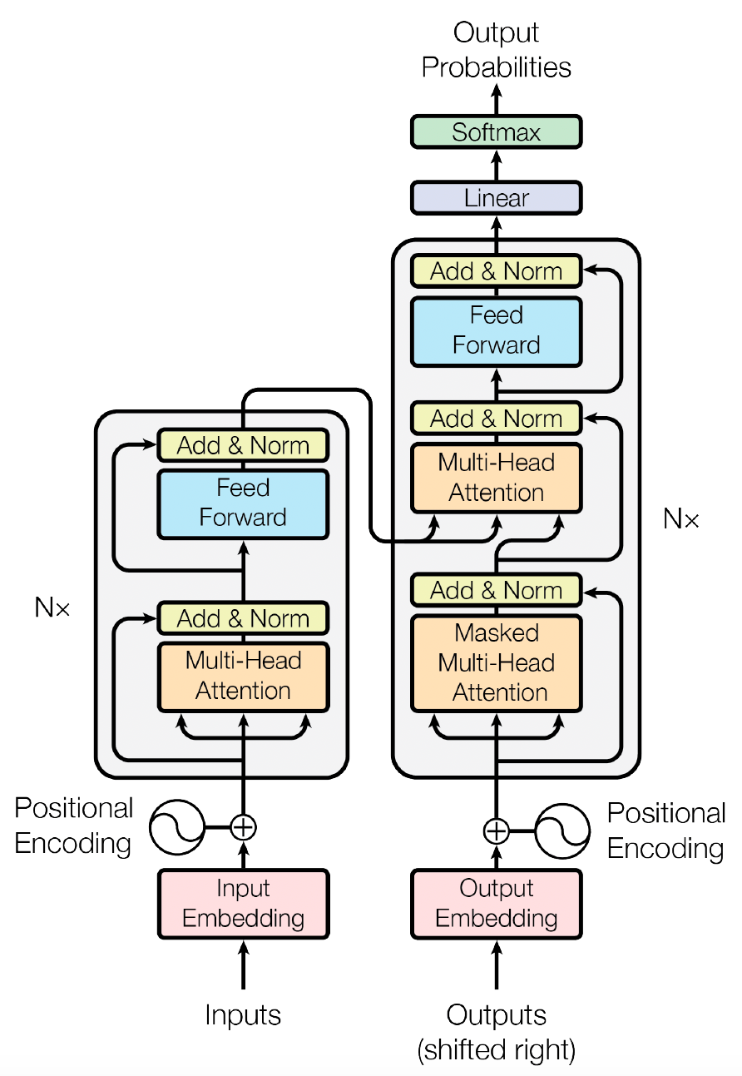
Autoregressive Models
Example: Transformer
Figure Source: Ashish Vaswani et. al. Attention is All You Need, NIPS 2017

Slide 18
Diffusion Models
Diffusion models are a class of generative machine learning models that create new data, such as images, audio, or video, by learning to reverse a gradual noise-adding process.
During training, random noise is progressively added to real data until it becomes nearly pure noise.
The model then learns how to remove this noise step by step, reconstructing the original data.
When generating new content, the process starts with random noise and iteratively denoises it to produce a realistic output.
Diffusion models have become highly influential in artificial intelligence because they can generate high-quality, diverse results and power systems such as image-generation tools, making them a key technology in modern generative AI.

Slide 19
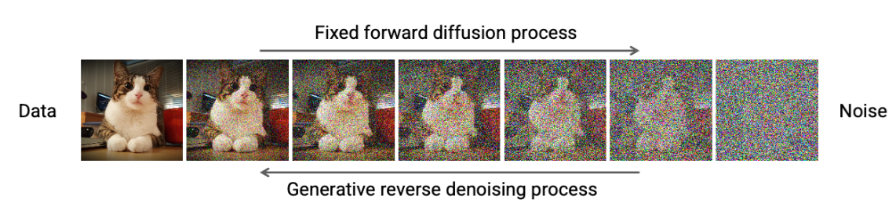
Diffusion Models
Forward Process: Gradually add Gaussian noise to data over many time steps until it becomes pure noise.
Backward Process: In backward process, the noise is gradually removed by sampling using annealed Langevin dynamics, so that the image gradually appears out from the Gaussian Noise.
Diffusion models explicitly encode this process using the concepts of forward and backward diffusion.
Image Source: CVPR 2022 Tutorial: https://cvpr2022-tutorial-diffusion-models.github.io/

Slide 20
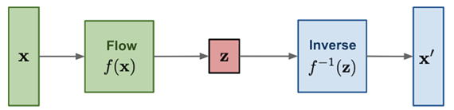
Normalizing Flows
Normalizing Flows are a family of generative models that learn complex data distributions by applying a sequence of invertible and differentiable transformations to a simple probability distribution, such as a Gaussian distribution.
Each transformation gradually maps the simple latent variables into data samples that resemble the training data while preserving the ability to compute exact probability densities through the change-of-variables formula.
Because every transformation is reversible, normalizing flows allow both efficient data generation and exact likelihood estimation, making them attractive for tasks such as image generation, density estimation, anomaly detection, and representation learning.
Their key advantage lies in combining tractable probabilistic modeling with flexible neural network-based transformations, enabling the modeling of highly complex data distributions.
Flow-based generative models: minimize the negative log-likelihood
Image Source: Weng, Lilian. (Jul 2021). What are diffusion models? Lil’Log. https://lilianweng.github.io/posts/2021-07-11-diffusion-models/.

Slide 21
Applications in Computer Vision
Image Synthesis
  Generate realistic human faces, landscapes, artwork, and objects.
Image-to-Image Translation
  Convert:
  Sketch → Photo
  Day → Night
  Summer → Winter
Super-Resolution
  Increase image quality and resolution.
  Examples include:
  Medical imaging
  Satellite imagery

Slide 22
Applications in Computer Vision
Image Inpainting
  Fill missing regions in damaged images.
Data Augmentation
  Generate synthetic training samples for limited datasets.
Video Generation
  Create realistic videos from text prompts or images.
3D Generation
  Generate:
  3D objects
  Neural radiance fields
  Virtual environments

Slide 23
Summary
Generative Modelling for Computer Vision
Generative Vision Models
Applications in Computer Vision

Slide 24
Mathematical Preliminaries
Next
Lecture 2:Part 1
Generative AI for Computer Vision

